Slide 1
Documenting Software Design
Lecturer: Ngo Huy Bien
Software Engineering Department
Faculty of Information Technology
VNUHCM - University of Science
Ho Chi Minh City, Vietnam
nhbien@fit.hcmus.edu.vn

Slide 2

Objectives
To document software design.

Slide 3

Contents
System Context Diagram
System Model Template
System Flow Diagram
Information Flow Model
Data Flow Diagram
Flowchart
UML Models

Slide 4

References
Roger S. Pressman (2010). Software Engineering: A Practitioner’s Approach.

Slide 5
Key Ideas
Notations.
Contents (aspects).

Slide 6
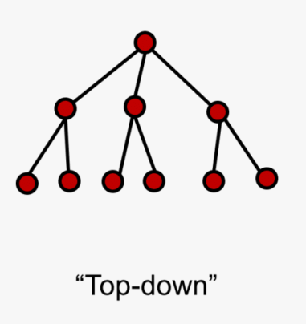

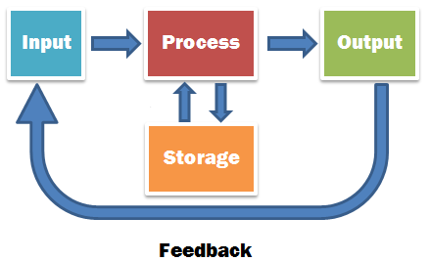
How to Represent a Design?

Slide 7
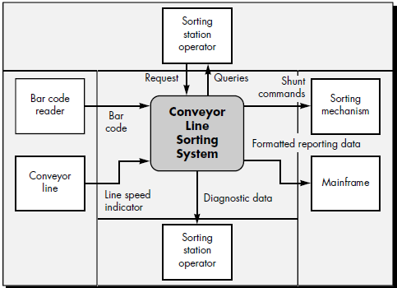
System Context Diagram [1]
The context diagram "establishes the information boundary between
the system being implemented and
the environment in which the system is to operate".
The SCD defines
all external producers of information used by the system,
all external consumers of information created by the system, and
all entities that communicate through the interface or perform maintenance and self-test.

Slide 8
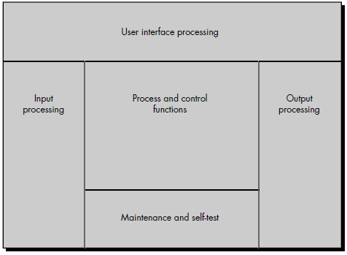
System Model Template
To develop the system model, a system model template is used.
The system engineer allocates system elements to each of five processing regions within the template:
(1) user interface,
(2) input,
(3) system function and control,
(4) output, and
(5) maintenance and self-test.

Slide 9
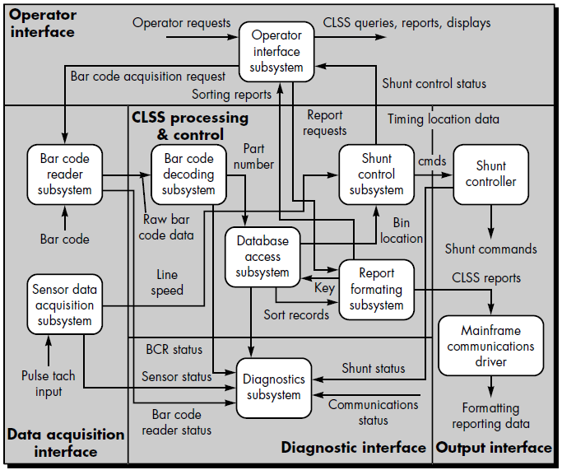
System Flow Diagram (SFD)
The system flow diagram shows major subsystems and important lines of information (data and control) flow.

Slide 10
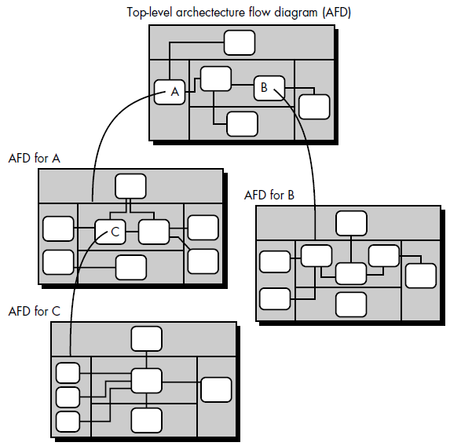
System Flow Diagram Hierarchy
Each rounded rectangle in the original SFD can be expanded into another architecture template dedicated solely to it.

Slide 11
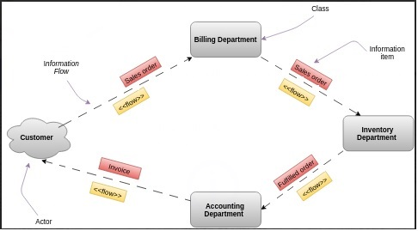
Information Flow Diagram
An information flow diagram is a diagram that shows how the information flows from a source to a target, which is through some medium.
The source or target may be people, departments or organizations.
The medium acts as a bridge, a means of transmitting the information.

Slide 12
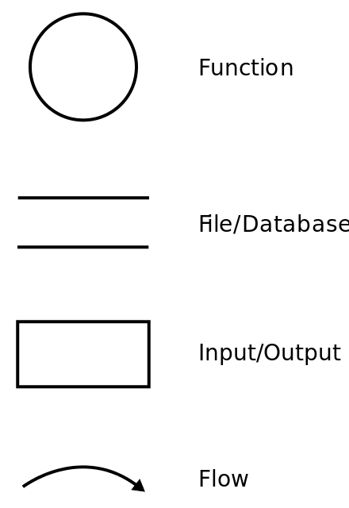
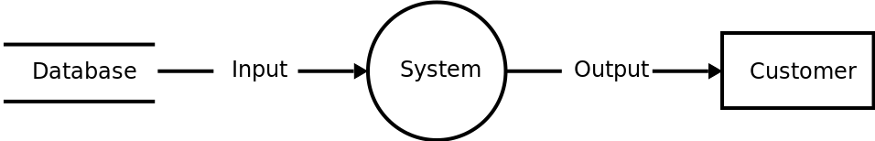
Data Flow Diagram
A data-flow diagram is a way of representing a flow of data through a process or a system (usually an information system).
The DFD also provides information about the outputs and inputs of each entity and the process itself.
A data-flow diagram has no control flow — there are no decision rules and no loops.

Slide 13


Slide 14

How to Represent an Algorithm?

Slide 15
Structured Programming
Dijkstra and others proposed the use of a set of constrained logical constructs from which any program could be formed.
The constructs are sequence, condition, and repetition.
Sequence implements processing steps that are essential in the specification of any algorithm.
Condition provides the facility for selected processing based on some logical occurrence, and
repetition allows for looping.
Each construct had a predictable logical structure, was entered at the top and exited at the bottom.
These three constructs are fundamental to structured programming—an important component-level design technique.

Slide 16
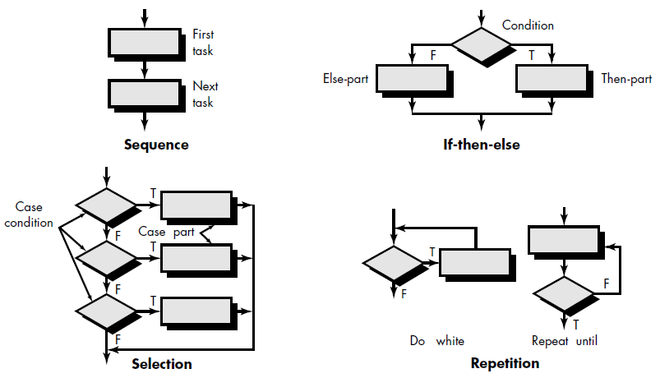
Flowchart Constructs
A box is used to indicate a processing step.
A diamond represents a logical condition, and arrows show the flow of control.

Slide 17
Flowchart
Flow charts are graphical representations of workflows of stepwise activities and actions with support for choice, iteration.

Slide 18

Why Flowchart?
Understand how algorithm works
Understand how a process is carried
Understand how a system works
Easy to find a problem

Slide 20


UML Models
Class diagram
Sequence diagram
Communication diagram
Activity diagram
State diagram
Refer to "Software Requirements" > "05.1. The Unified Modeling Language.pptx" for details.

Slide 21
UML is Semi-Formal Language
It has a well-defined syntax (so it is computer-readable), but not an inherent, unambiguous and precise (in terms of mathematical precision) semantics.
The semantics of a UML element is provided in prose, which is inherently ambiguous.
As a result, a UML model can be read by a computer, but due to the lack of formalized semantics, a UML model cannot be computed in a deterministic way.
There is a subset of UML, called fUML that is a formalized subset suitable for precise execution semantics.

Slide 22
What does a Sequence Diagram Mean?
Sequence Diagrams don't have precise semantics.
In general, what does a Sequence Diagram mean?
Is it a universal specification ("this is how the system will always behave" therefore there are no other allowable behaviors)?
Or is it an existential specification ("this is a scenario which the system should support" therefore a system that doesn't is incorrect)?
Or is it merely a description ("this might happen")?
There is no answer, because Sequence Diagrams don't have precise semantics like that.

Slide 23
fUML
https://www.omg.org/spec/FUML
The Foundational UML Subset (fUML) is an executable subset of standard UML that can be used to define, in an operational style, the structural and behavioral semantics of systems.
For example, the semantics of UML state machines can be specified as a program written in fUML.

Slide 24

Thank You & See You Again

